Slide 1
Machine Learning
Asieh Daneshi 2024

Slide 2
What is Machine Learning?
Machine Learning is a subdomain of computer science that focuses on algorithms which help a computer learn from data without explicit programming
What is the difference between AI and ML and DS?
Artificial intelligence is an area of computer science, where the goal is to enable computers and machines to perform human-like tasks and simulate human behavior
Machine learning is subset of AI that tries to solve a specific problem and make predictions using data
Data science is a field that attempts to find patterns and draw insights from data (might use ML!)

Slide 3
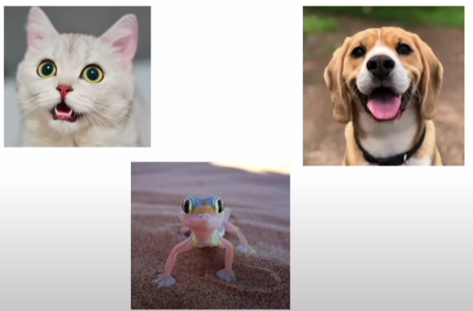
Types of Machine Learning
Supervised learning - uses labeled inputs (meaning the input has a corresponding output label) to train models and learn outputs
Cat Dog Frog

Slide 4
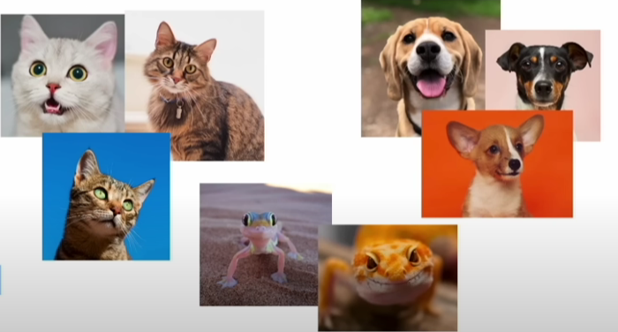
Types of Machine Learning
Supervised learning - uses labeled inputs (meaning the input has a corresponding output label) to train models and learn outputs
Unsupervised learning - uses unlabeled data to learn about patterns in data

Slide 5


Types of Machine Learning
Supervised learning - uses labeled inputs (meaning the input has a corresponding output label) to train models and learn outputs
Unsupervised learning - uses unlabeled data to learn about patterns in data
Reinforcement learning – agent learning in interactive environment based on reward and penalties

Slide 6
Machine Learning
Input 1
Input 2
Output (prediction)
Model
…
Input n
Notes:
This is the general structure of a machine-learning model.
Today, we focus on supervised learning. But before that, let’s make sure that we are on the same page and use the same names for the same concepts.

Slide 7


Features
Qualitative – categorical data (finite number of categories or groups)
Nominal Data (no inherent order)

Slide 8
One-Hot Encoding
Every time we just focus on a specific category and label data from that category 1, and all the others are 0
Country | One-Hot Encoding
Japan | 1,0,0,0
China | 0,1,0,0
Germany | 0,0,1,0
Canada | 0,0,0,1

Slide 9

Features
Qualitative – categorical data (finite number of categories or groups)
Ordinal Data (inherent order)

Slide 10
We can assign a number to any of these categories
1 2 3 4 5 6 7 8 9

Slide 11
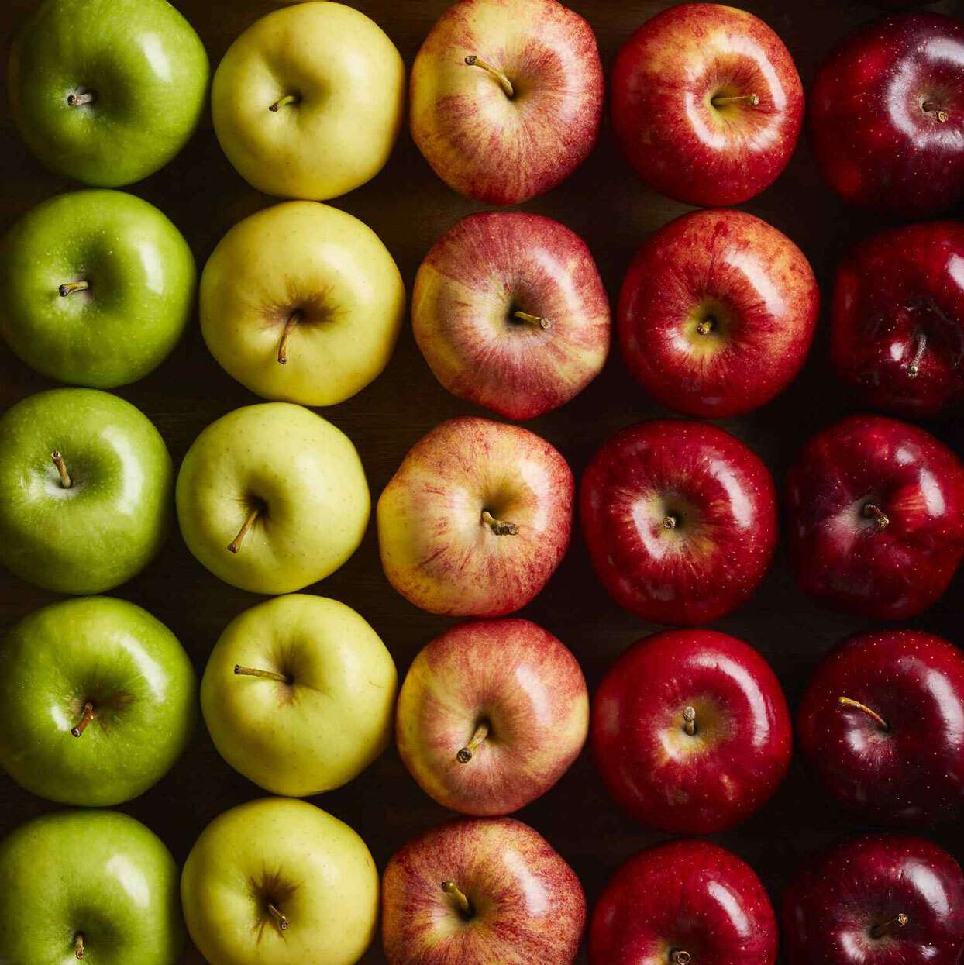
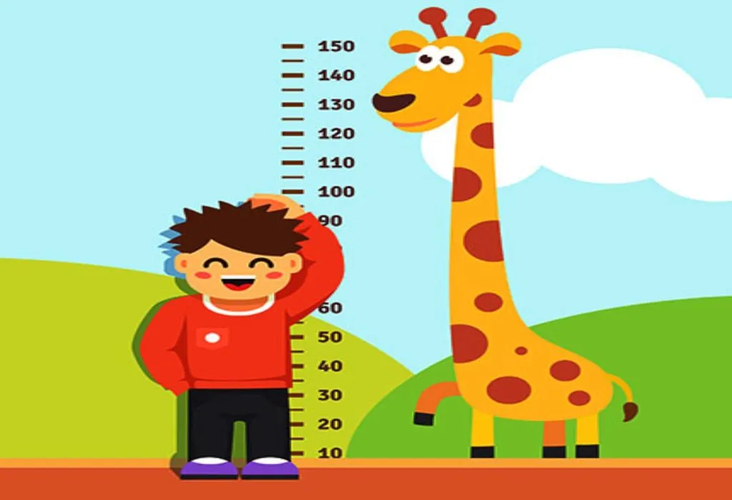
Features
Quantitative – numerical valued data (discrete or continuous)

Slide 12
Machine Learning
Input 1
Input 2
Output (prediction)
Model
…
Input n
Notes:
This is the general structure of a machine-learning model.
Today, we focus on supervised learning. But before that, let’s make sure that we are on the same page and use the same names for the same concepts.

Slide 13
Supervised Learning
Classification – predict discrete classes
Multiclass classification
Notes:
This is the general structure of a machine-learning model.
Today, we focus on supervised learning. But before that, let’s make sure that we are on the same page and use the same names for the same concepts.

Slide 14
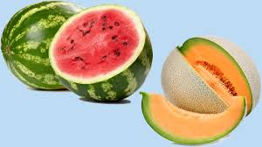
Classification – predict discrete classes
Binary classification
Notes:
This is the general structure of a machine-learning model.
Today, we focus on supervised learning. But before that, let’s make sure that we are on the same page and use the same names for the same concepts.

Slide 15

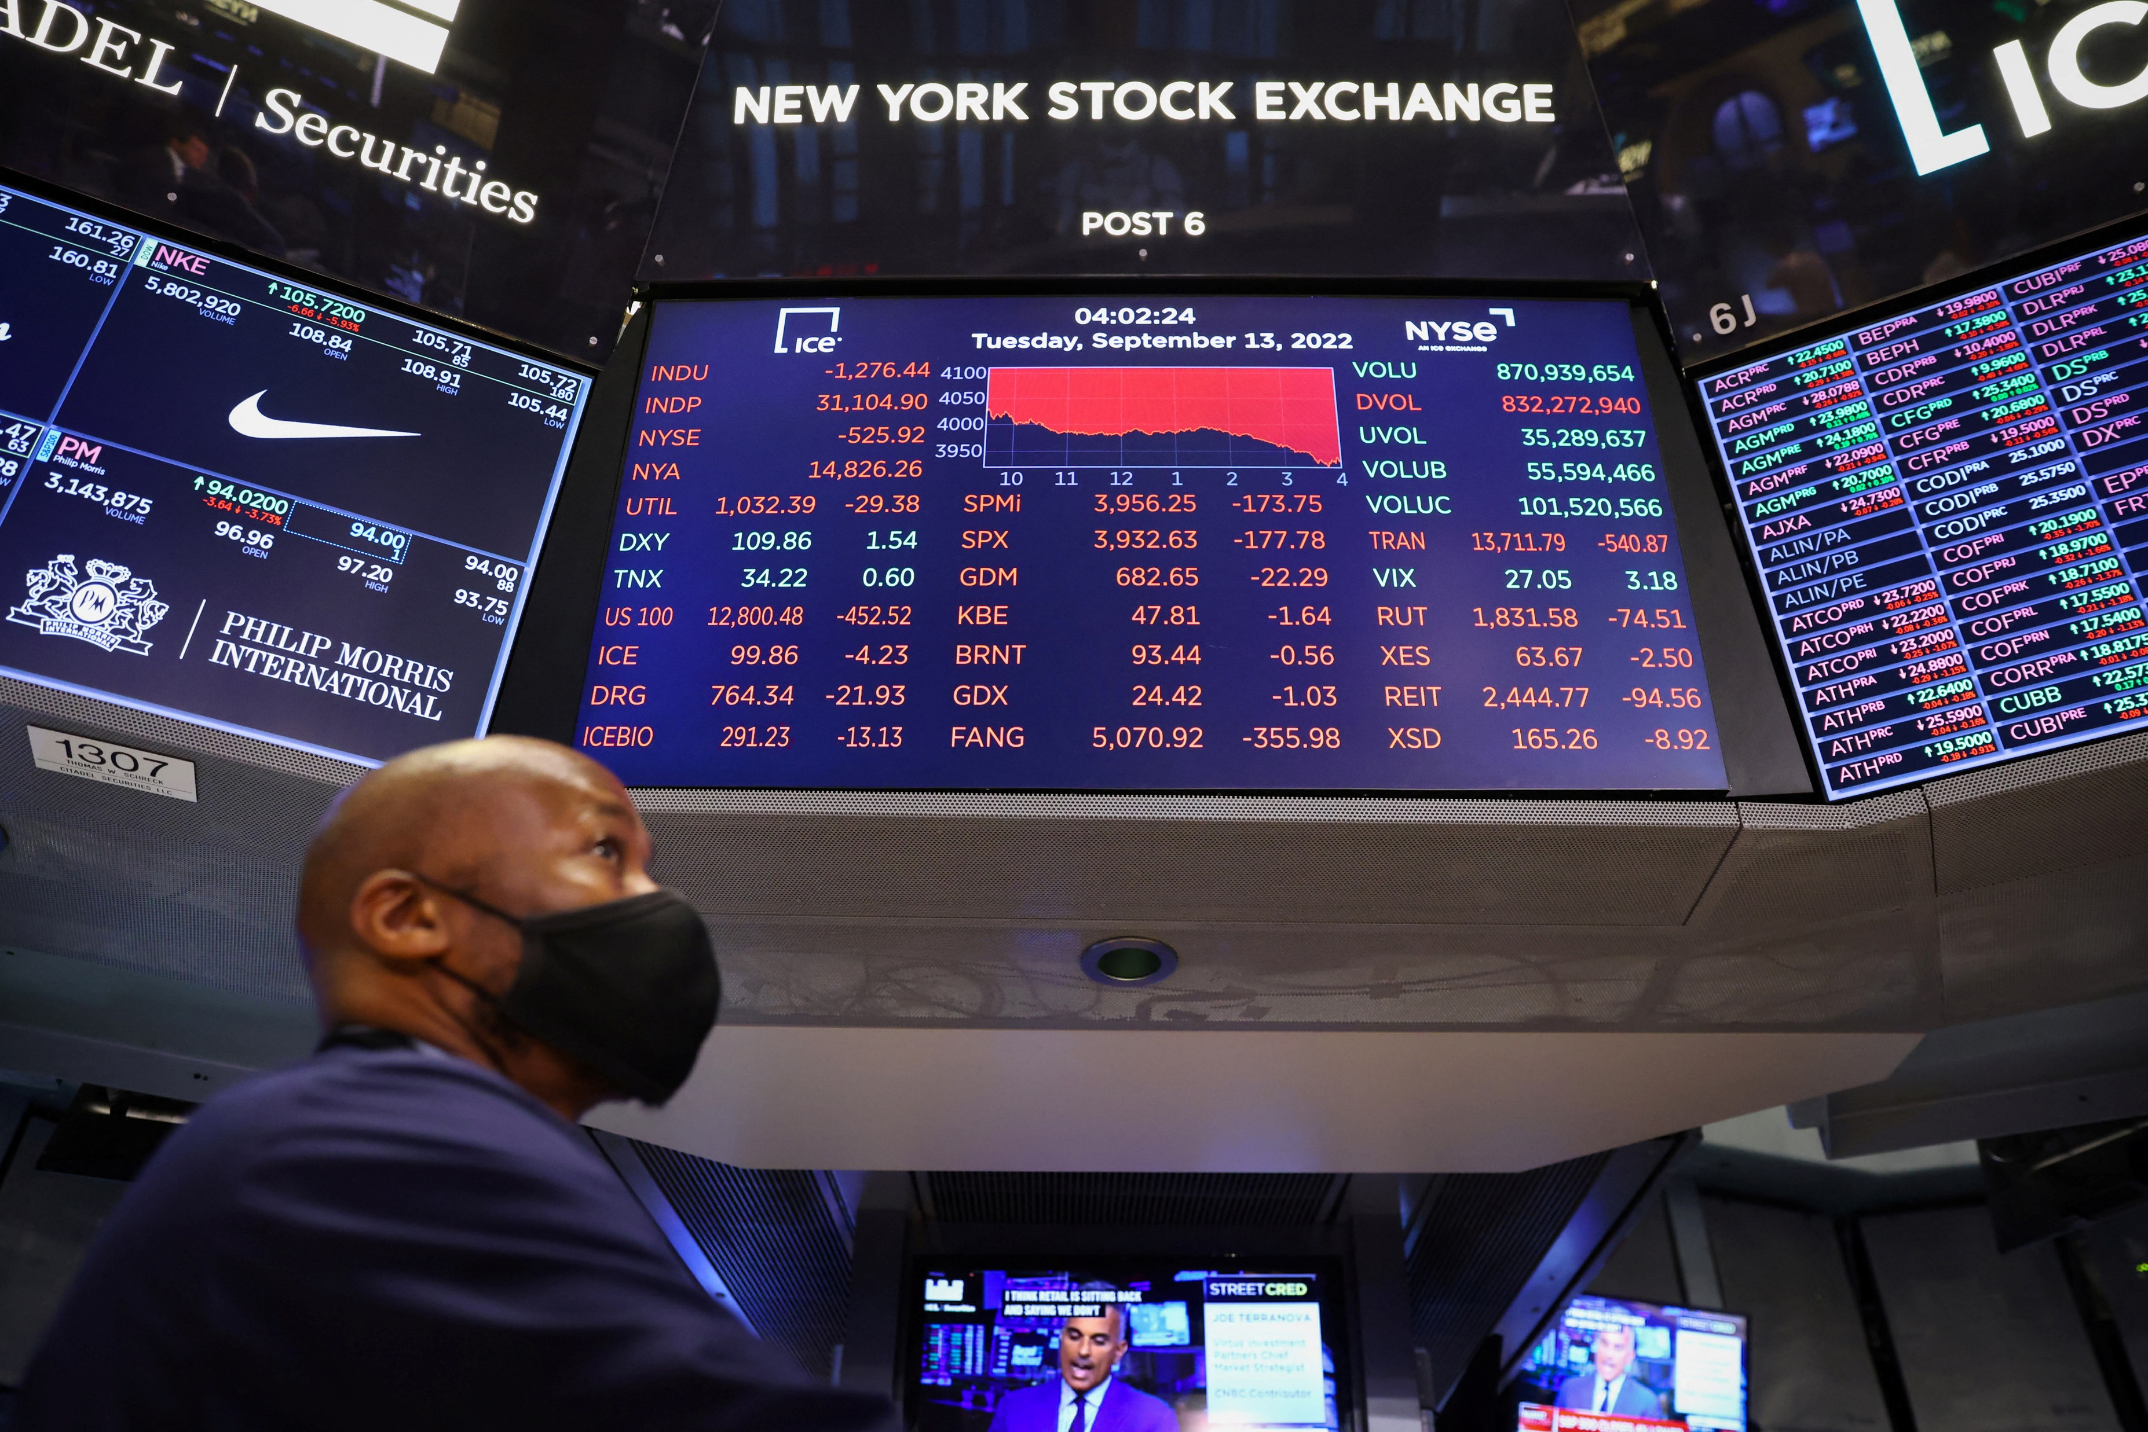
Supervised Learning
Regression – predict continuous values
Notes:
This is the general structure of a machine-learning model.
Today, we focus on supervised learning. But before that, let’s make sure that we are on the same page and use the same names for the same concepts.

Slide 16

Training
Model
Don’t use all chocolates for training!
. . .
Notes:
We feed data row by row to our model, and receive output.

Slide 17
Training dataset
Validation dataset
Testing dataset

Slide 18
Training
Model
. . .
Loss
Notes:
During the training process, we adjust our model to decrease the loss function as much as possible!

Slide 19
Validation
Model
Loss
Notes:
To make sure that the model works with new data!

Slide 20
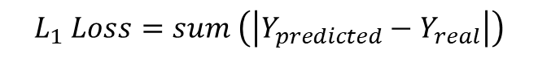

$$L_{1} Loss=sum \left(\left|Y_{predicted}−Y_{real}\right|\right)$$
$$L_{2} Loss=sum \left({\left(Y_{predicted}−Y_{real}\right)}^{2}\right)$$

Slide 21

Binary Cross-Entropy $Loss=−\frac{1}{N}∗sum(y_{real}∗\log\left(y_{predicted}\right)+\left(1−y_{real}\right)∗log⁡(1−y_{predicted}))$
In this function, loss decreases as the performance gets better!

Slide 22
Metrics of performance: Accuracy

Slide 23
First, convert the labels from letters to numbers.
df["class"] = (df["class"] == "g").astype(int)
df["class"] = df['class'].astype('category').cat.codes
labels = df["class"]
label_mapping = {uniqueClasses[0]:0, uniqueClasses[1]:1}
numerical_labels = [label_mapping[label] for label in labels]
df["class"]=numerical_labels
We have collected 10 parameters (independent variables). Which one can represent and distinguish the two classes of our data the best?
Plot histograms!
Python reminder:
df[“A”][b]: element of df in column with label “A” and in row [b]
df[df[cond]][“B”]: elements of df in column with label “B”, satisfying condition cond
df[df[cond]].iloc[b]: the bth row of subset of df satisfying condition cond
*plt.hist(df[df["class"]==1][fSize])
Which feature (parameter) do you think is the best for our classification task?

Slide 24
Now, divide data into train, validation and test sets
We can use numpy.split for this purpose
np.split(dataFrame, [first portion, second portion, …, the remaining])
But …
It just put the rows of dataFrame as it is, without changing their order! What can we do to change the order?
Use dataFrame.sample
df.sample(frac=1, replace=False): this code shuffles our data

Slide 25
Let’s start with looking into our data:
df = pd.read_csv("Session1Data.data")
The data comes from a telescope. There are some high-energy particles that the telescope is observing their radiation. The dataset includes some features recorded from these particles and their radiations that help us to understand if the particles were gamma or hadron.
cols = ["fLength", "fWidth", "fSize", "fConc", "fConc1", "fAsym", "fM3Long", "fM3Trans", "fAlpha", "fDist", "class"]
df = pd.read_csv("Session1Data.data", names=cols)
Variable Name | Role | Type | Description | Units | Missing Values
fLength | Feature | Continuous | major axis of ellipse | mm | no
fWidth | Feature | Continuous | minor axis of ellipse | mm | no
fSize | Feature | Continuous | 10-log of sum of content of all pixels | #phot | no
fConc | Feature | Continuous | ratio of sum of two highest pixels over fSize |  | no
fConc1 | Feature | Continuous | ratio of highest pixel over fSize |  | no
fAsym | Feature | Continuous | distance from highest pixel to center, projected onto major axis |  | no
fM3Long | Feature | Continuous | 3rd root of third moment along major axis | mm | no
fM3Trans | Feature | Continuous | 3rd root of third moment along minor axis | mm | no
fAlpha | Feature | Continuous | angle of major axis with vector to origin | deg | no
fDist | Feature | Continuous | distance from origin to center of ellipse | mm | no

Slide 26
To see the first 5 rows of our data:
df.head()
To see how the different elements in a data column use:
.unique()
df["class"].unique()
To convert qualitative (categorical) to quantitative (nominal), if we have only two categories:
df["class"] = (df["class"] == "g").astype(int)
If we have more than two categories:
df["class"] = df['class'].astype('category').cat.codes
Or, do the mapping manually:
labels = df["class"]
label_mapping = {uniqueClasses[0]:0, uniqueClasses[1]:1}
numerical_labels = [label_mapping[label] for label in labels]
df["class"]=numerical_labels

